Slide 1

E-CERTIFICATES ISSUE SERVICES USING BLOCKCHAIN
Date: 22 June 2021
Ms. MANDALA SUSMITHA : 17WH1A0591
Ms. AREPALLI SINDHURA : 17WH1A05A6
Ms. V KRISHNA GAYATRI : 18WH5A0521
Internal Guide: Prof. R S MURALI NATH
Designation: Professor I/C Accreditations
Department of Computer Science & Engineering
BVRIT HYDERABAD College of Engineering for Women

Slide 2
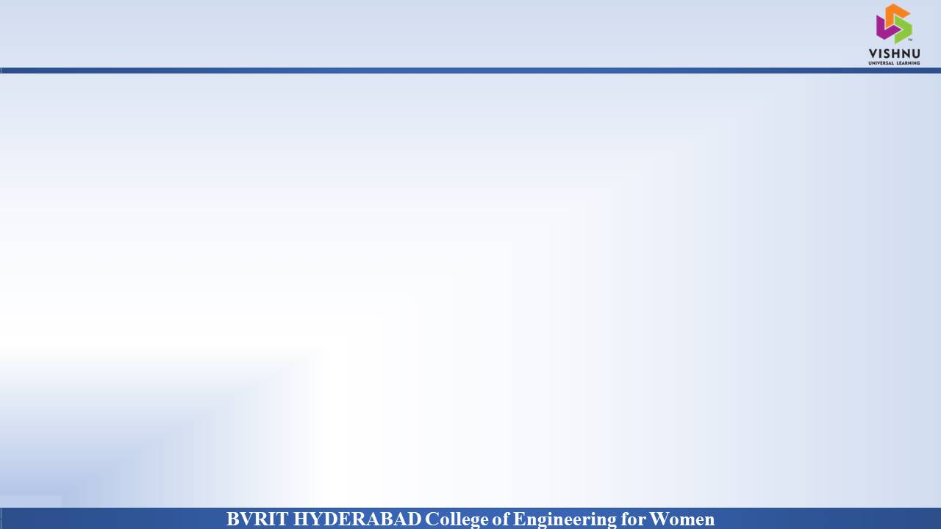
Abstract
Why Should I Study this course?
Students often have to go to their colleges in order to collect their certificates. There might be many of them who might be working or studying at different places and may not be able to come to college to collect the documents needed. This project aims to reduce this difficulty by providing a website to students wherein they can request for the documents they need. The user will be authorized based on their college email id and password. They can then go to the home page and click on the certificate they need.
The student can request to get any of the following certificates : Academic certificates such as marks memo, certificates provided after graduation – CMM(Consolidated Marks Memo), OD(Original Degree), TC(Transfer certificate) and recommendation letters for higher studies. These requests to get certificates is sent to examination branch and/or concerned authorities who will upload the scanned copes . These certificates will be stored in blockchain to make them tamper-free. The students can download these certificates. The students can apply for recommendation letters from particular faculty member. The faculty member will be able to view the request and upload the letter.
Examples
BVRIT HYDERABAD College of Engineering for Women

Slide 3
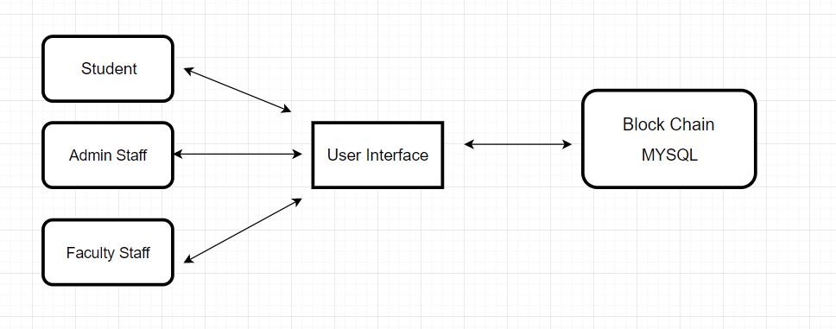
Architecture Diagram
BVRIT HYDERABAD College of Engineering for Women

Slide 4
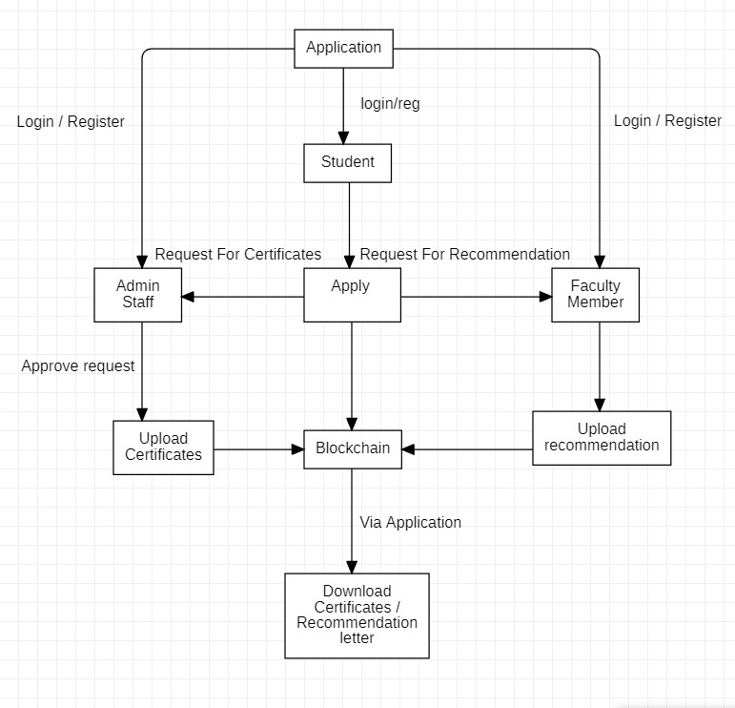
Flow Diagram
Why Should I Study this course?
Examples

Slide 5
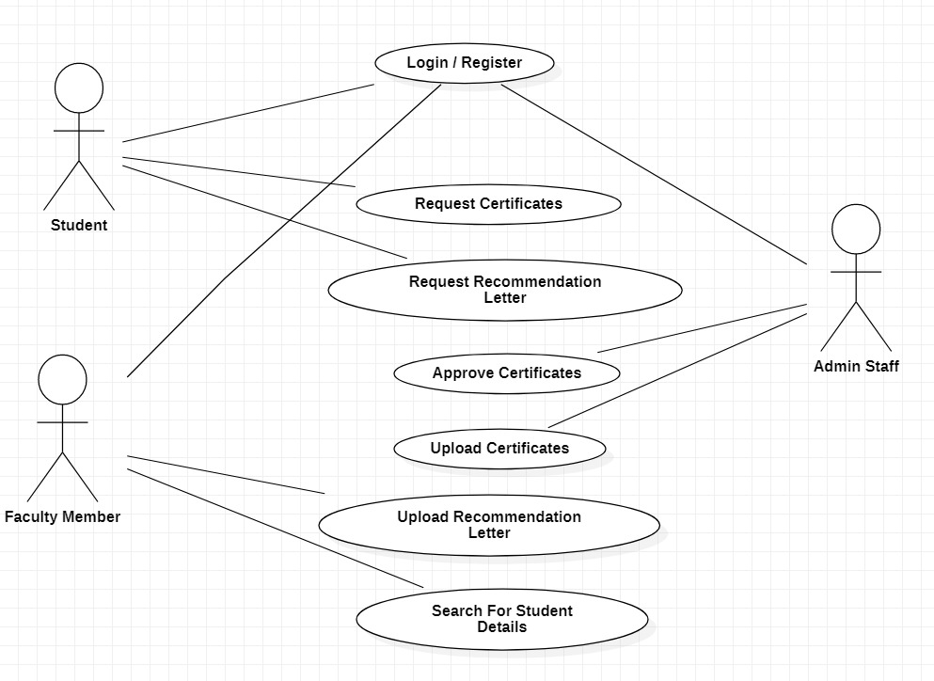
Use Case Diagram
Why Should I Study this course?
Examples
BVRIT HYDERABAD College of Engineering for Women

Slide 6
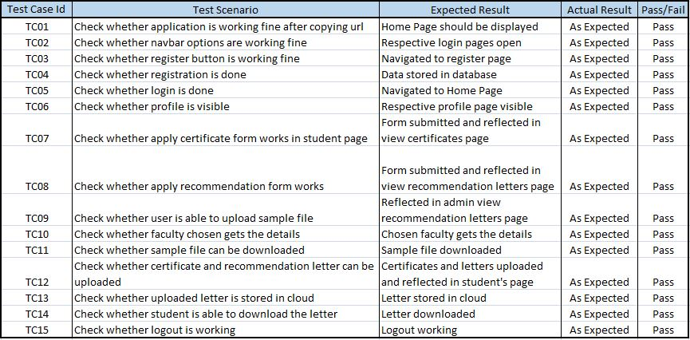
Test Cases
BVRIT HYDERABAD College of Engineering for Women

Slide 7
Technology Stack
Programming Language – Java
GUI – HTML, CSS with Bootstrap, JSP
Libraries – MYSQL connector jar file, Apache Tomcat jar file
Framework – Java EE
Tools - Eclipse, MYSQL
BVRIT HYDERABAD College of Engineering for Women

Slide 8
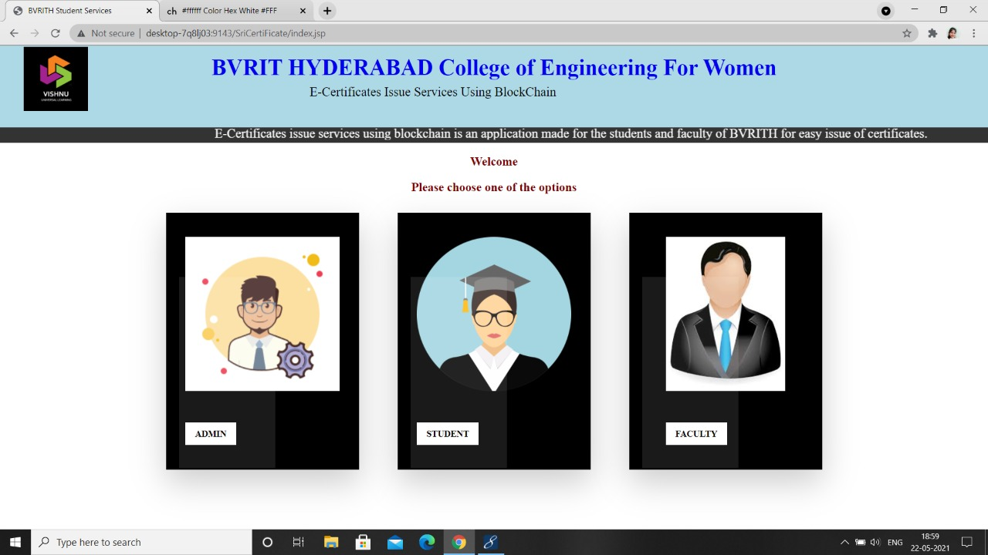
Outputs
BVRIT HYDERABAD College of Engineering for Women

Slide 9
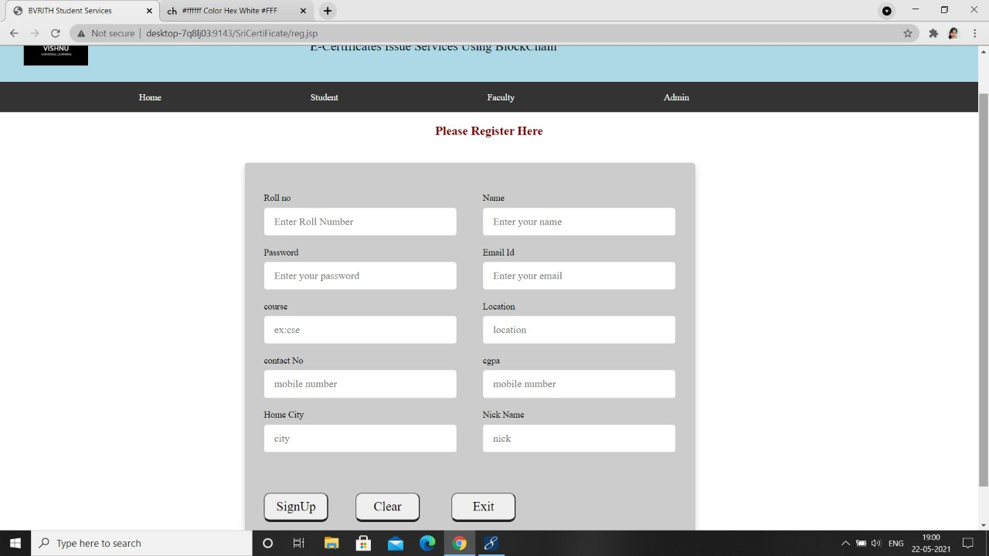
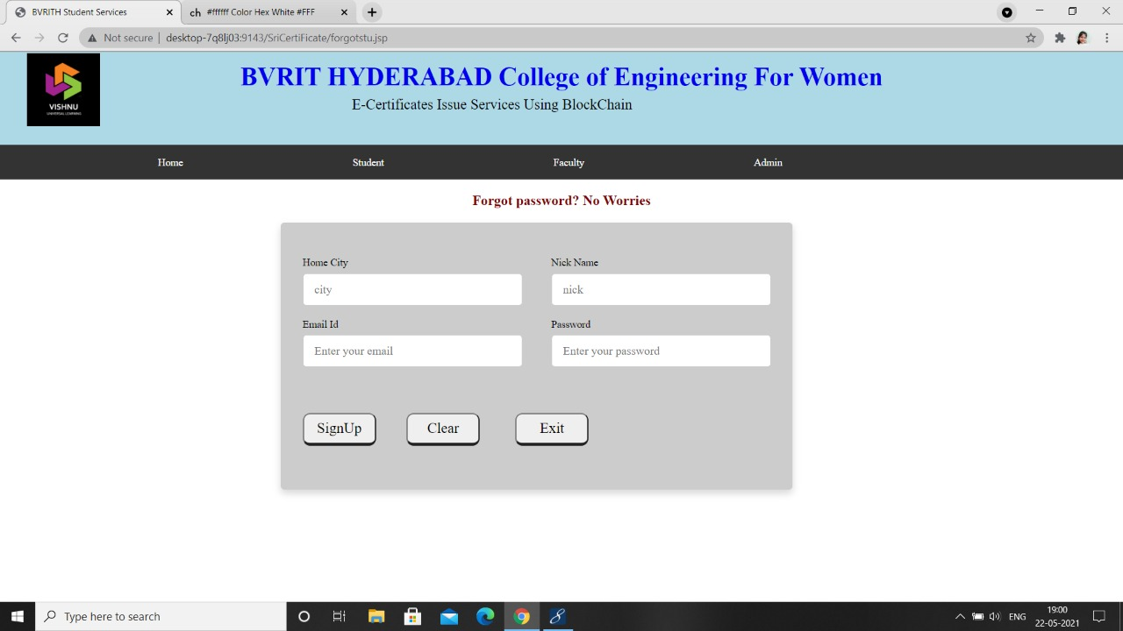
Registration
Forgot password
BVRIT HYDERABAD College of Engineering for Women

Slide 10
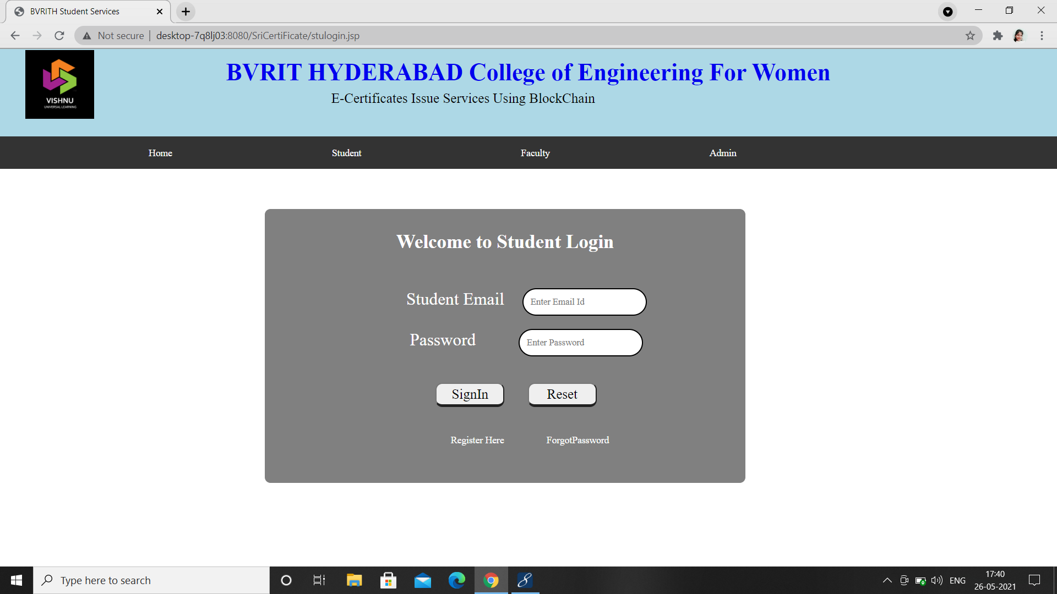
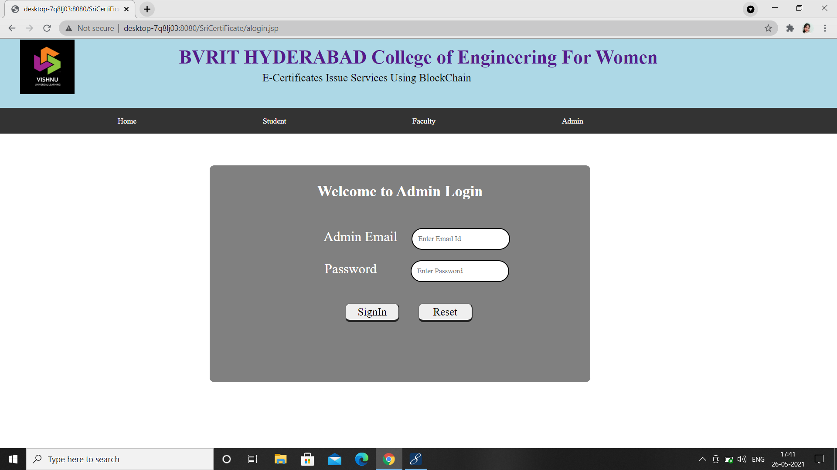
Student Login
Admin Login
BVRIT HYDERABAD College of Engineering for Women

Slide 11
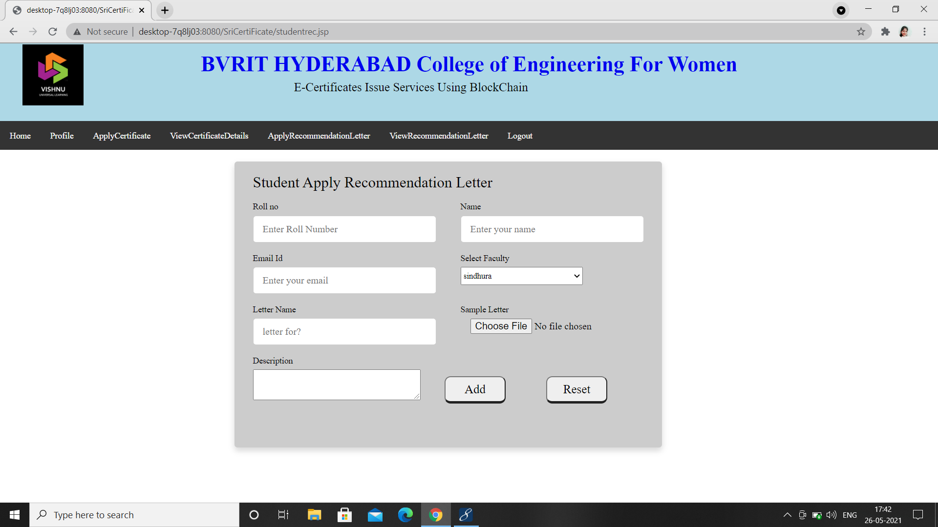
Apply For Recommendation Letter
BVRIT HYDERABAD College of Engineering for Women

Slide 12
References
[1] John Wiley and Sons, 1982. Dinesh Kumar K, Senthil P, Manoj Kumar D.S : Educational Certificate
Verification System Using Blockchain in 2020
[2] Neethu Gopal, Vani V Prakash : Survey on Blockchain Based Digital Certificate System in 2018
[3] Anjaneyulu Endurthi, Akhil Khare : Certificate Management System Using Blockchain in 2020
[4] Nitin Kumavat, Swapnil Mengade, Dishant Desai, Jesal Varolia : Certificate Verification System using
Blockchain in 2019.
BVRIT HYDERABAD College of Engineering for Women

Slide 13
Thankyou
BVRIT HYDERABAD College of Engineering for Women

